Slide 1

Department of Artificial Intelligence and Data Science
Real-Time Ingredient Recognition and Recipe Generator
Mrs.Y.Nirmala Anandhi M.E.,(Ph.D.,)
Assistant Professor (SS)
Sanjay B (221801045)
Soorya B (221801051)
Thofiq Gani M (221801057)

Slide 2
Problem Statement and Motivation
Problem Statement : Manual recipe planning is often slow and inefficient, causing many ingredients to remain unused and ultimately wasted. Existing recipe applications do not support real-time ingredient recognition from images, nor can they dynamically generate personalized recipes based on what users already have. This lack of automation reduces convenience and limits effective meal preparation, especially for users seeking quick, accurate cooking guidance.
Motivation : There is a growing need for smart kitchen tools that help people reduce food waste and make cooking easier. Many users struggle to decide what to cook with the ingredients they already have. An AI-based system that can recognize ingredients and suggest recipes instantly can make meal preparation faster, simpler, and more efficient.

Slide 3
Existing System
Manual Ingredient Input: Most apps require users to type ingredients manually, which is time-consuming and prone to errors.
No Real-Time Detection: Lack of live camera-based recognition, forcing users to search recipes separately after checking ingredients.
No AI-Powered Suggestions: Systems rely on keyword matching instead of smart, context-aware recipe recommendations.
Static Recipe Databases: Recipes are pre-defined, not dynamically generated based on detected ingredients, limiting flexibility.
No Waste Reduction Focus: Most platforms don’t prioritize expiring or leftover ingredients, missing sustainability opportunities.
Limited Personalization: Existing systems do not adapt recipes based on user preferences, dietary needs, or cooking skill level, reducing user satisfaction and practicality.

Slide 4
Objectives
The objective of this project is to develop an AI-driven system that combines real-time ingredient detection with AI-powered recipe generation to instantly recognize food items from images or live camera feeds and generate personalized recipes based on available ingredients, user preferences, and dietary restrictions. This system aims to simplify meal planning, reduce food waste by suggesting recipes for unused ingredients, and enhance cooking efficiency—providing a smart, sustainable solution for home cooks, busy professionals, and environmentally conscious users while promoting resource optimization in kitchens.

Slide 5
Abstract
This project proposes a real-time ingredient recognition and recipe generation system using AI-powered object detection and natural language processing. By leveraging computer vision techniques (e.g., SSD or CNN-based models), the system identifies ingredients from images or live camera feeds, then generates personalized recipes using a language model (e.g., GPT or LLAMA). The solution aims to reduce food waste, assist in meal planning, and enhance cooking efficiency by providing instant recipe suggestions based on available ingredients.

Slide 6
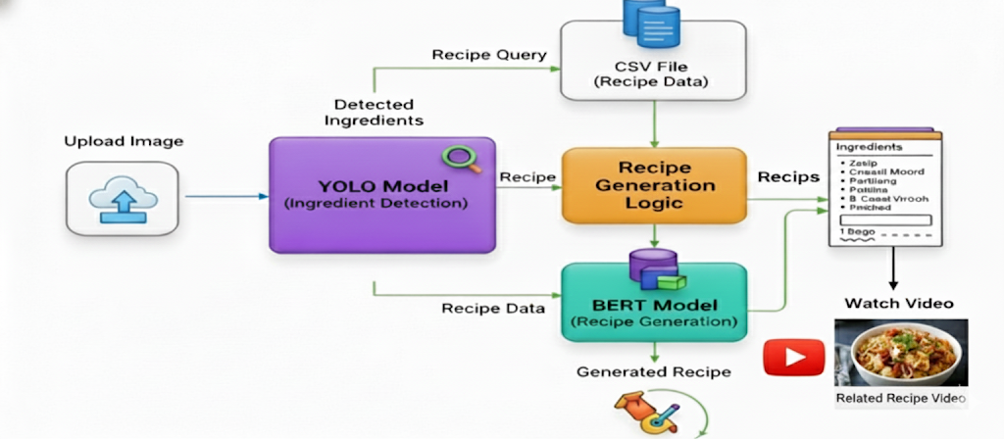
Architecture(framework)

Slide 7
Architecture(framework)
Component | Function | Technology
Input | Captures real-time image feed. | Upload Input (Captured Image)
Detection | Identifies available ingredients. | YOLO Model (Object Detection)
Data Source | Stores the complete recipe catalog. | CSV File (Recipe Data)
Logic | Matches detected items to recipes. | Recipe Generation Logic
Generation | Formulates step-by-step instructions. | BERT Model (NLP Generation)
Output | Presents recipe details and visual guide. | Generated Recipe & Related Recipe Video

Slide 8
Module
User Interface & Input Module
Provides an interactive interface for the user.
Allows users to upload images.
Performs initial preprocessing of images:
  Resizing to standard dimensions.
  Color normalization or enhancement.
  Optional noise reduction.
Ensures the image is ready for the detection module.
Input: User image (camera capture or upload).
Output: Preprocessed image ready for ingredient detection.

Slide 9
Module
Ingredient Detection Module (YOLOv12)
Detects and identifies multiple ingredients in real time.
Uses a YOLOv12 object detection model for fast and accurate recognition.
Processes the preprocessed image from the UI module.
Generates a list of detected ingredients with:
  Labels (e.g., tomato, onion, potato).
  Confidence scores.
  Optional bounding box coordinates.
Input: Preprocessed image from UI/Input module.
Output: List of detected ingredients with labels.

Slide 10
Module
Recipe Retrieval & Generation Module (CSV + BERT)
Retrieves recipes from a CSV dataset based on the detected ingredients.
Filters and ranks recipes for the best matches.
Uses BERT to refine recipe instructions:
  Makes the instructions coherent and easy to read.
  Ensures proper sequencing of steps.
  Adjusts ingredient quantities or measurements if necessary.
Input: Detected ingredient list from YOLO; CSV dataset.
Output: Refined, human-readable recipe instructions.

Slide 11
Module
Final Output & Display Module
Presents the complete recipe to the user in an organized format.
Includes:
  Ingredient list.
  Step-by-step cooking instructions.
  Optional images or videos for better guidance.
Ensures the recipe is display-ready and user-friendly.
Input: Refined recipe instructions from the Recipe Generation module.
Output: Display-ready recipe with all details and multimedia elements.

Slide 12
Conclusion
This project demonstrates an effective AI-based solution for real-time ingredient recognition and automated recipe generation. By combining computer vision for detecting ingredients and natural language processing for creating personalized recipes, the system significantly simplifies meal preparation. It reduces the need for manual ingredient input, minimizes food waste, and enhances user convenience by offering instant, smart recipe suggestions based on available items. Overall, the system provides a practical and intelligent tool that supports efficient, sustainable, and user-friendly cooking.

Slide 13
Thank You

